Slide 1
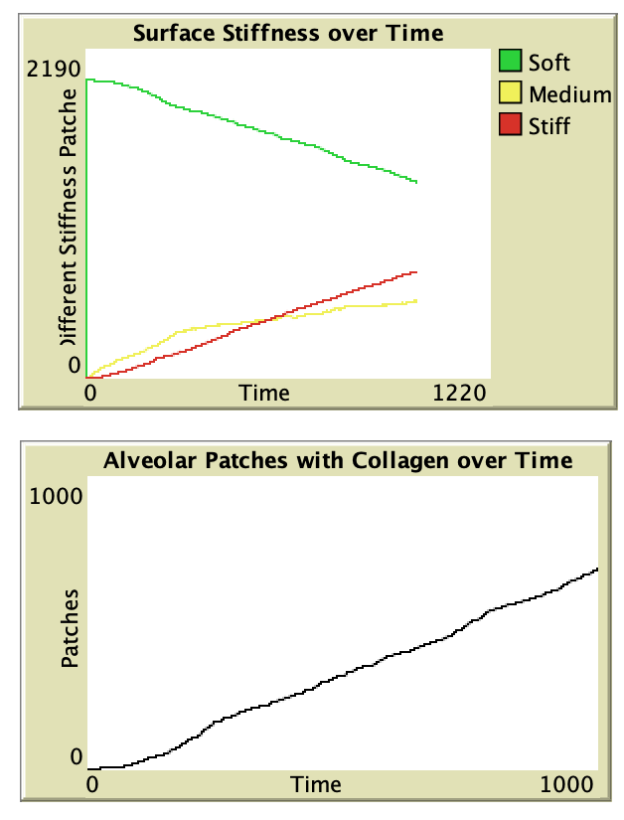

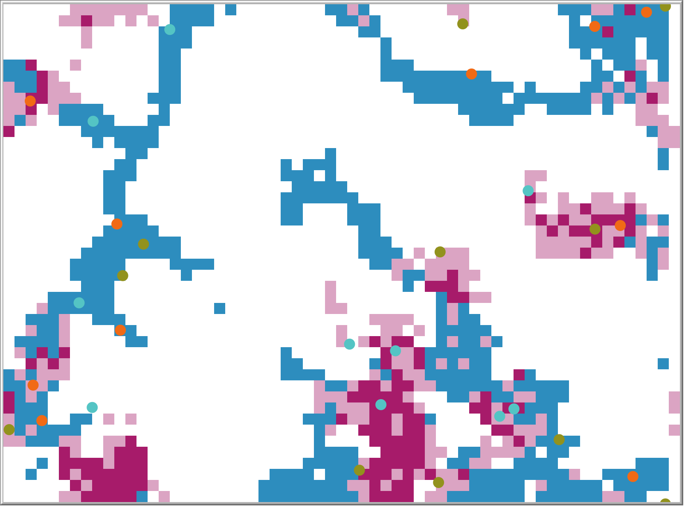
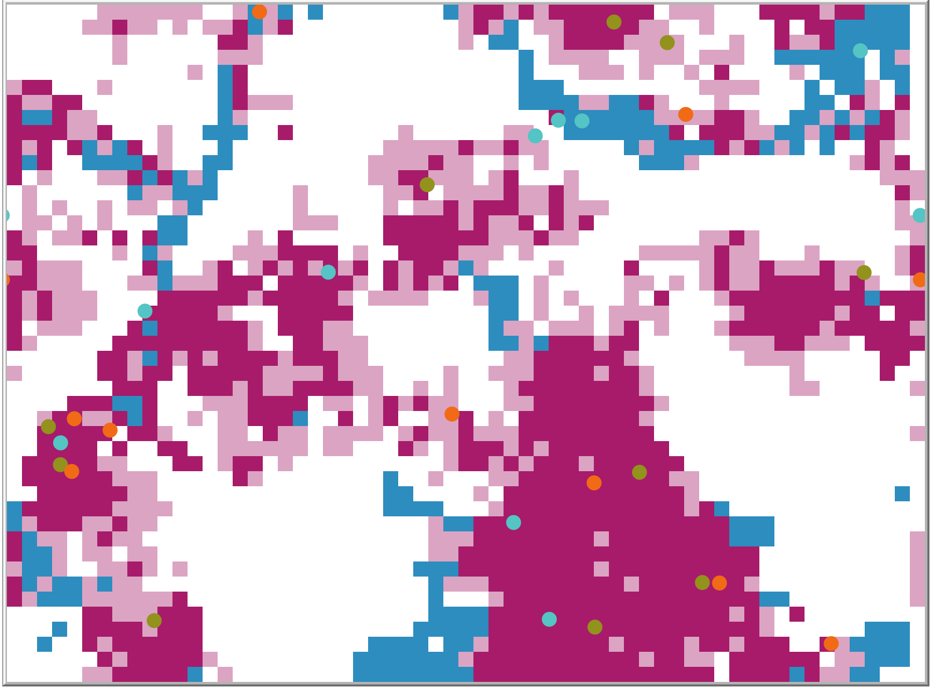
Interstitial Space
High Collagen Deposition
Thy1+
Thy1-
Alveolar Space
Medium Collagen Deposition
Degrader
Healthy
12 months
24 months

